Slide 1
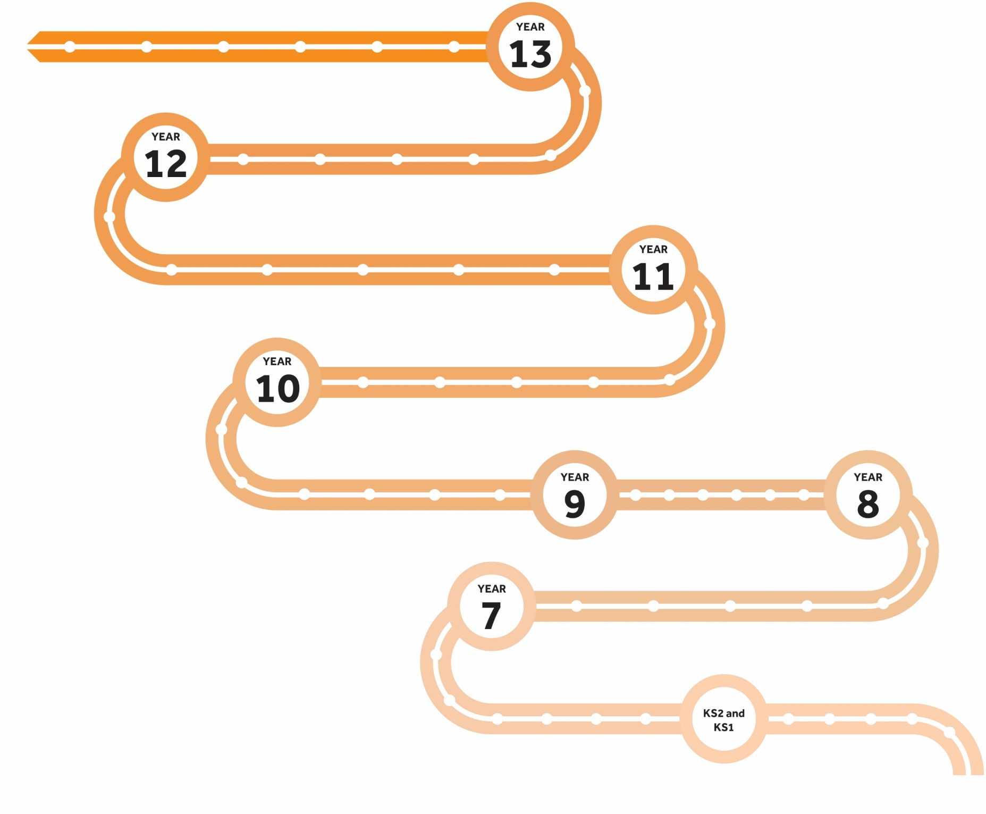
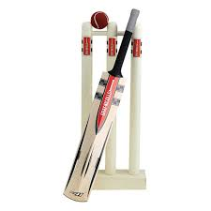
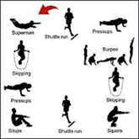
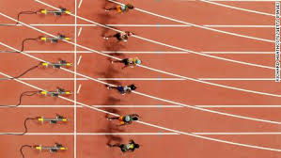
OUR LEARNING
JOURNEY
PE KS3
Links to KS4 Topics
All Sports and Activities Covered in Greater Detail
Half
Term
6
Cricket and Netball
Skills, rules, positions, tactics, application, timing and measuring.
Assessment
Health and Fitness Homework Booklet
Links to maths.
Half
Term
5
Badminton & Athletics
Skills, rules, positions, tactics,
application, timing and measuring.
Assessment
Links to maths.
Half
Term
4
Tennis & Volleyball
Skills, rules, positions, tactics and application.
Assessment
Nutrition Booklet
Links to food.
Half
Term
3
Tag rugby & Fitness
Skills, rules, tactics, application, movements, sequences, components
of fitness and training
methods.
Assessment
Half
Term
2
Table Tennis & Danish Longball
Skills, rules, tactics, application, movements and sequences.
Assessment
Links to biology science
Half
Term
1
Table tennis & Football
Skills, rules, positions, tactics and application.
Assessment
Skill cards
Links to maths
Units of Work
Assessment Points
Cross Curriculum Links
Key Knowledge & Skills
Active Reading

