Slide 1
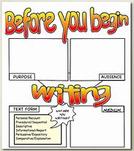
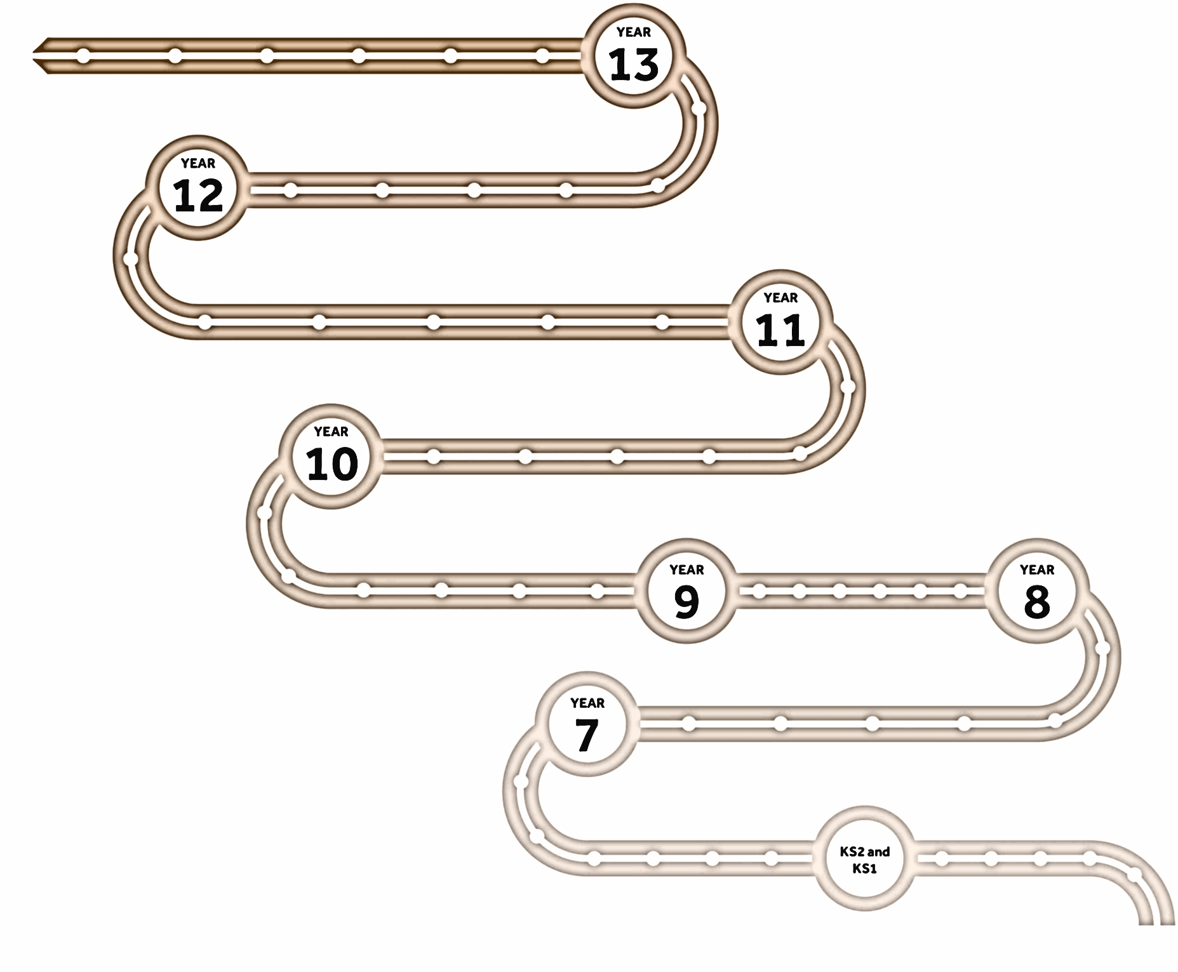
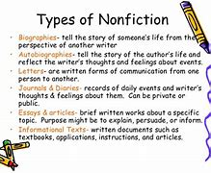
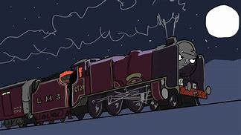
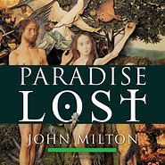
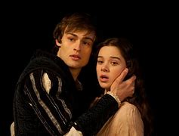
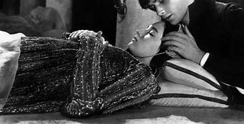
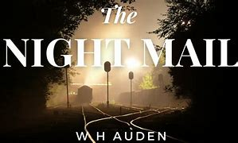
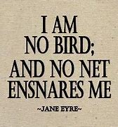
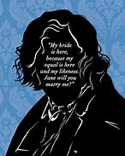
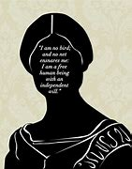
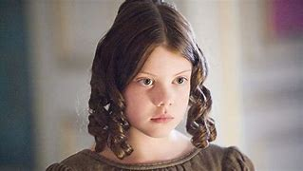
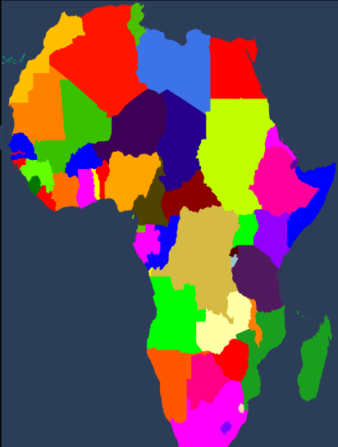
My Y9 Learning Journey in English
Reading for Study
Reading nineteenth, twentieth and twenty-first century non-fiction; writing a letter, article, speech, essay; purpose, audience, formality, style.
GL Assessment
Poetry
Extended metaphors; Paradise Lost, ‘The Road Not Taken’, ‘Night Mail’, ‘The Canterbury Tales’ poets studied include John Milton, W.H. Auden, Grace Nichols, Wallace Willis
Romeo and Juliet
GL Assessment
The Prologue; foreshadowing in Romeo and Juliet; the form of a tragedy.
Jane Eyre
Victorian attitudes to children and childhood; rural isolation; Christianity; Victorian sickness; juxtaposition in Jane Eyre.
GL Assessment
Units of Work
Assessment Points
Cross Curriculum Links
Key Knowledge & Skills
Active Reading

